Slide 1
Deduplicating Cloud Functions - Demo 3
Members:
Beliz Kaleli
Vikash Sahu
Paritosh Shirodkar
Asutosh Patra
Mentor:
Shripad Nadgowda
Notes:
‹#›

Slide 2
Previously in De-duplicating...
Earlier, all the components (Minio, Kafka, CouchDB & OpenWhisk) were executing independently in local machines
Interaction among the components was not done
The feedback from the last sprint was to deploy the whole framework into cloud and execute

Slide 3
What did we achieve in this sprint?
Deployed all the individual components in the cloud
Built the sanity framework to avoid deduplication of cloud function
Successfully implemented deduplication of cloud function for Image Thumbnail Use Case

Slide 4
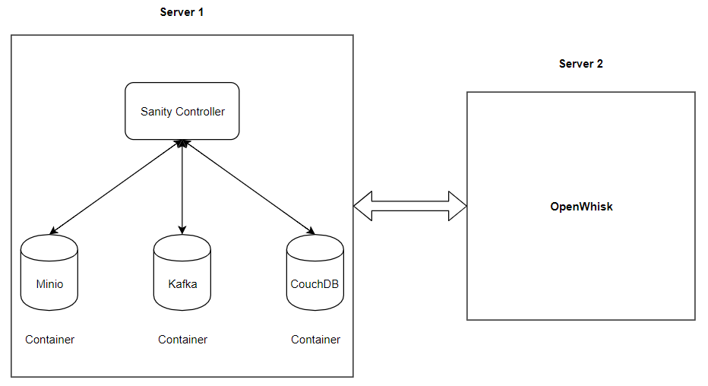
Now, Simplified working model in IBM Cloud

Slide 5
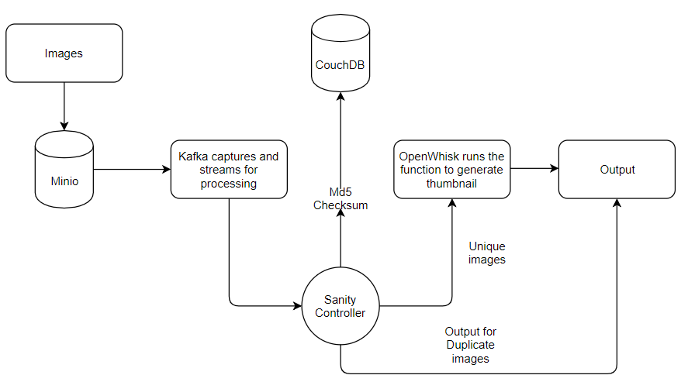
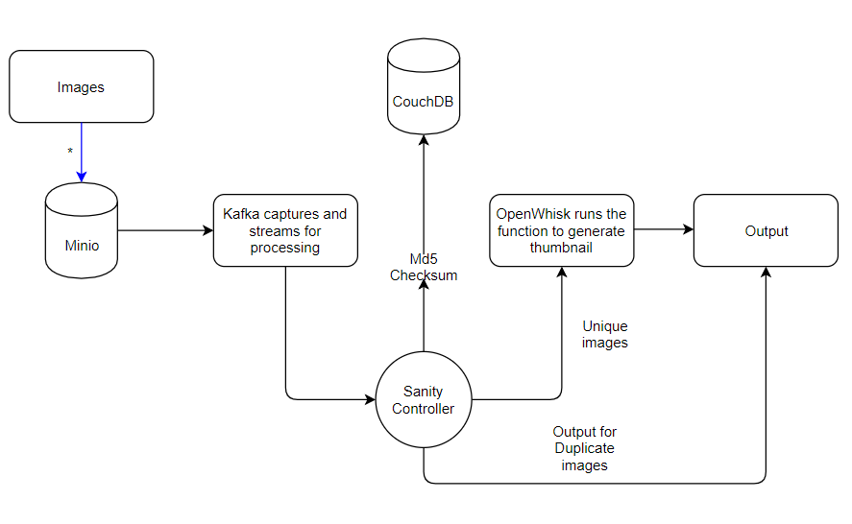
Architecture Diagram

Slide 6
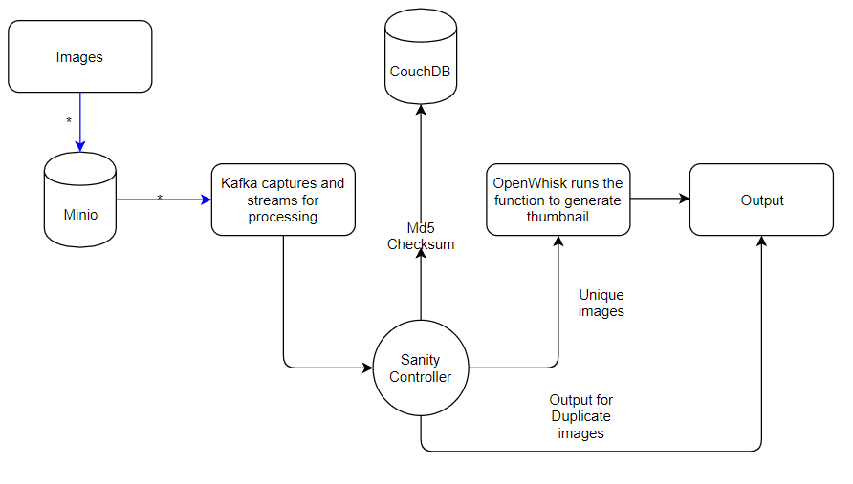

Slide 7
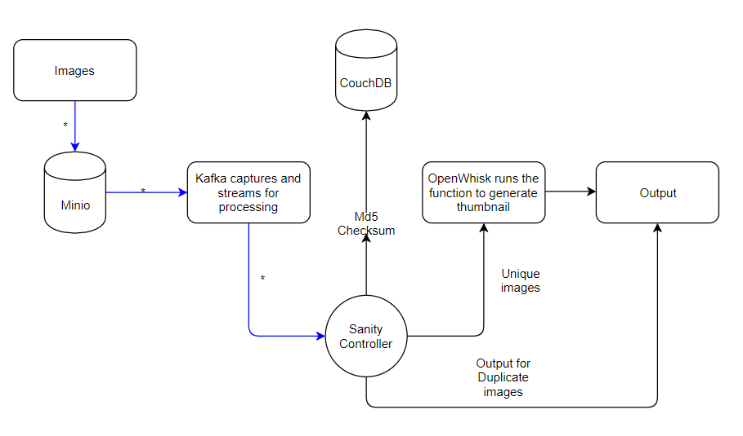

Slide 8
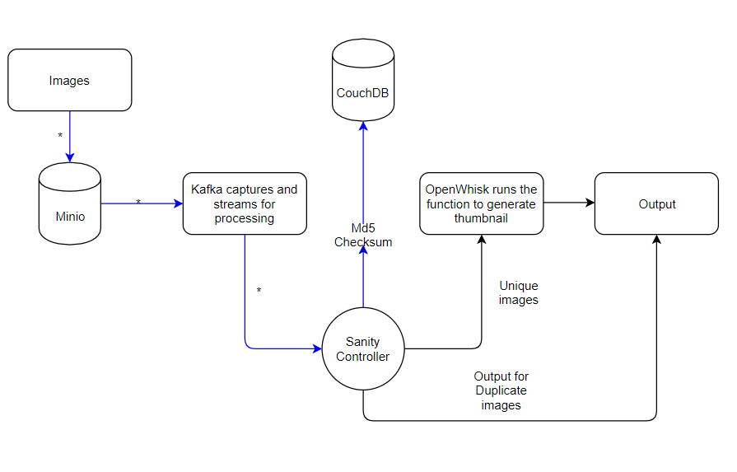

Slide 9
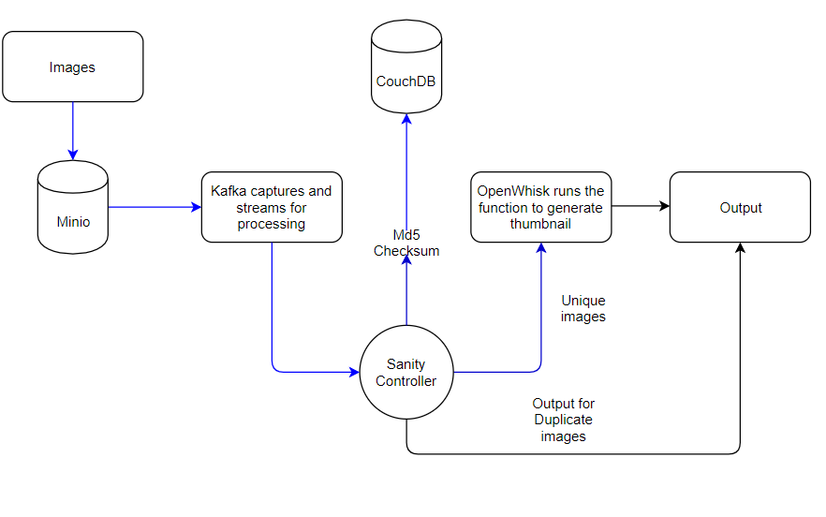

Slide 10
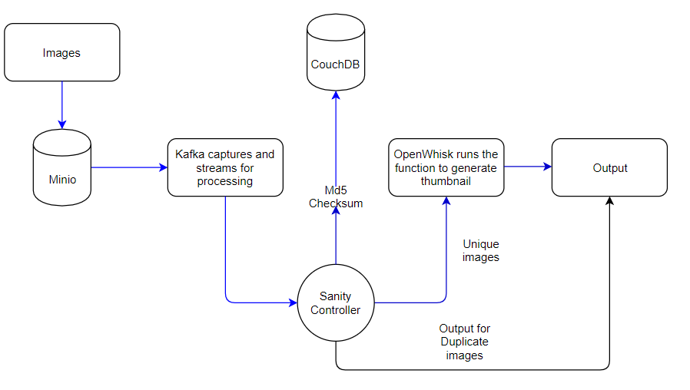

Slide 11
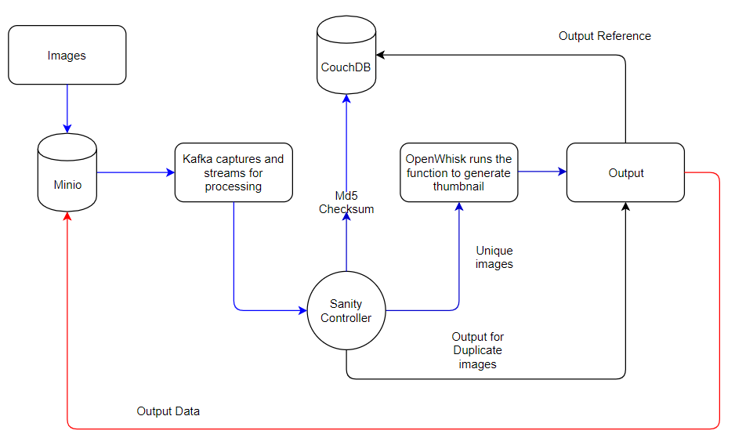

Slide 12
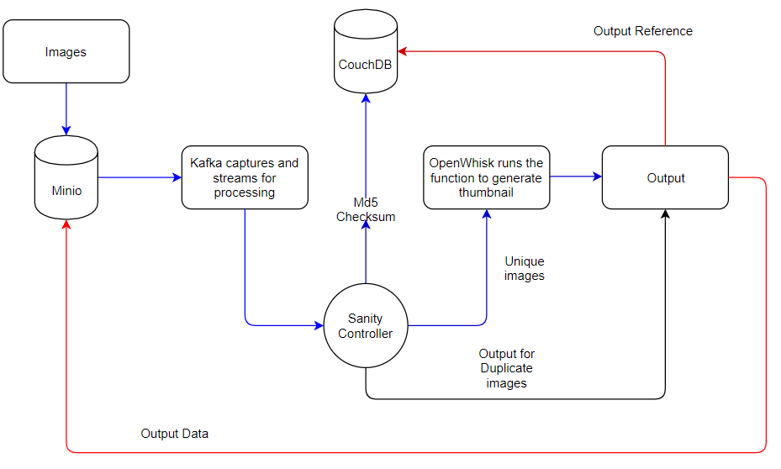

Slide 13
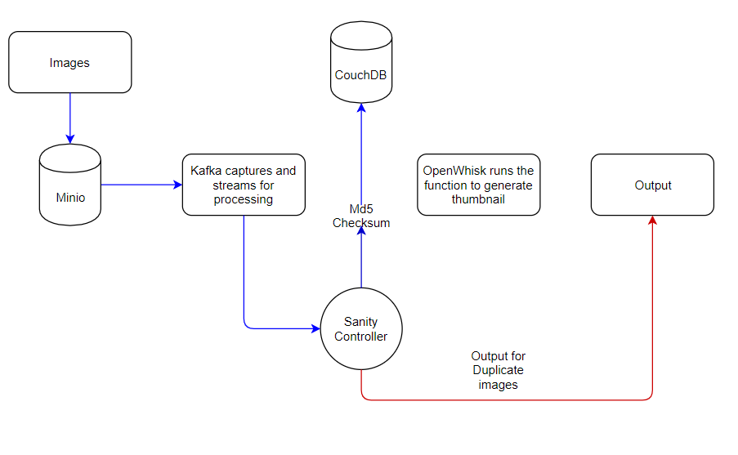

Slide 14
DEMO

Slide 15
How is deduplication achieved via Sanity Framework
Upload a file to a Minio bucket (ex: inbucket, a.jpg)
> mc cp a.jpg myminio/inbucket
Create a function (ex: myfunction) with wsk client
> wsk -i action create myfunction.py myfunction
Invoke the function with the uploaded file
> wsk -i action invoke myfunction inbucket/a.jpg outbucket
Result is automatically stored in Minio bucket(ex: outbucket)
For duplicate images, we get the reference from Sanity and for unique images, openwhisk executes action and stores the thumbnail, hence de duplication of functions is achieved.

Slide 16
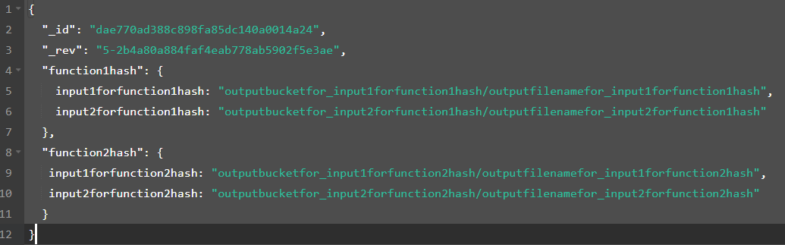
Couch DB
input_checksum
output_bucket/output_file

Slide 17
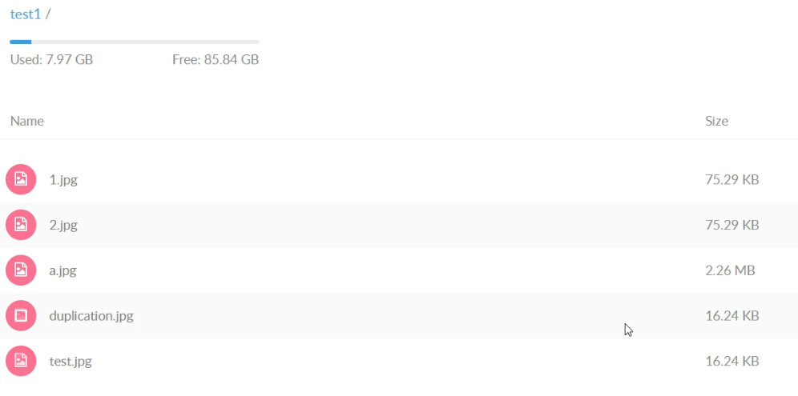
Deduplication In Progress..
Same file, different name!

Slide 18
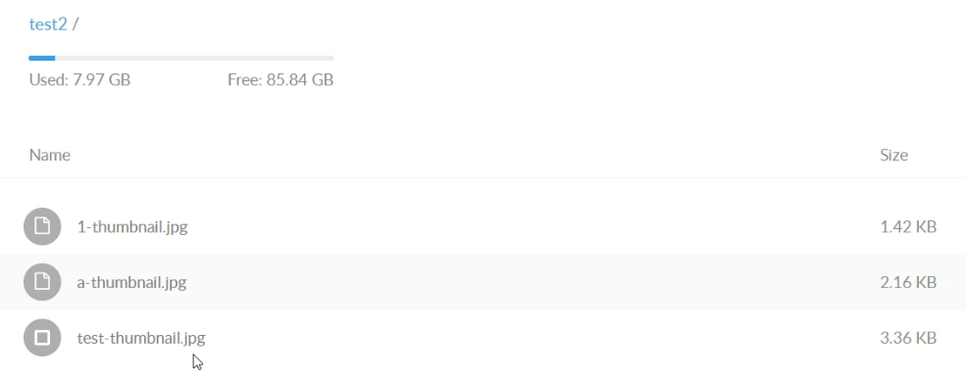
After Running: Only one output for both files!
only output for test.jpg and duplication.jpg

Slide 19
Challenges in Current Sprint
Configuring docker components in cloud and executing functions in them
How can we invoke custom docker scripts in openwhisk?
Creating network connection between two servers in IBM cloud
Simulating the entire pipeline with all the components in place in cloud

Slide 20
Next Steps (Sprint - 4)
Implementing the Command Line Interface
Benchmarking performance savings for entire process
Brainstorm with our mentor to improve our current framework

Slide 21
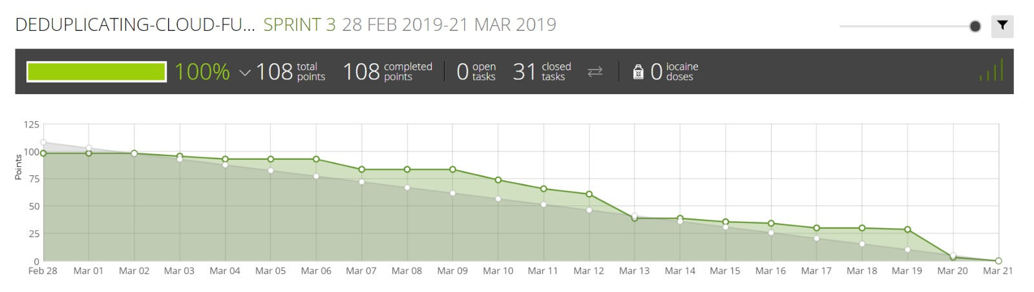
Burndown Chart

Slide 22
THANK YOU

